Slide 1
The George Washington University
Advanced Software Paradigm
Evaluating Advanced Programming Language
(DART)
Authors:
Ebrahim Bonger
Abdul Bashir Kamal Summer 2021

Slide 2
Dart Criteria for programming language evaluation
Dart Language Objected-oriented concept
Dart supports all the features-oriented program
The oops concepts are given below.
Class
Object
Inheritance
Interface
Polymorphism
Abstract class

Slide 3
Dart classes and object
Dart classes are defined as the blueprint of the associated object .
class ClassName {
<fields>
<getter/setter>
<constructor>
<functions>
}
The object has two characteristics - state and behavior.
var objectName = new ClassName(<constructor_arguments>)

Slide 4
Dart Inheritance
Dart has single inheritance
class Orbiter extends Spacecraft {
double altitude;
Orbiter(String name, DateTime launchDate, this.altitude)
: super(name, launchDate);
}

Slide 5
Dart Interface & Abstract
The Interface is defined as a blueprint of the class
Dart does not have a syntax for declaring interfaces.
Classes declarations are themselves interfaces in Dart
Abstract Classes in Dart is defined for those classes which contain one or more than one abstract method
abstract class ClassName {
//Body of abstract class
}

Slide 6
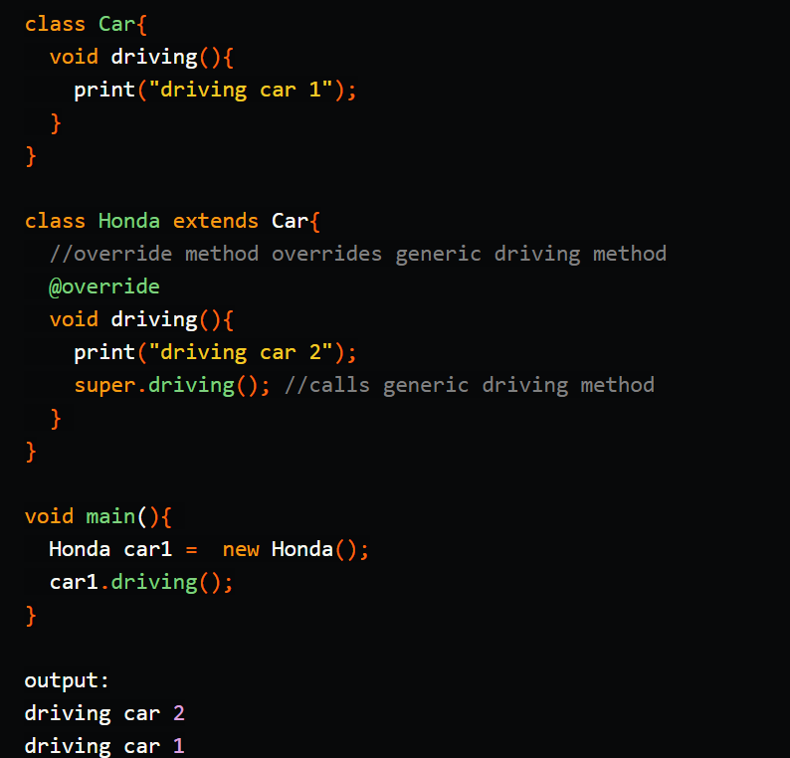
Dart support Polymorphism Example
Polymorphism, means creating many forms or configurations.

Slide 7
Dart evaluate programming language
Dart is a language worth learning
Dart was introduced in 2011
Dart programming language optimized for Android, iOS, Windows, MacOS and different other device platform.
Google use Dart language
Dart compilers are quick and reliable

Slide 8
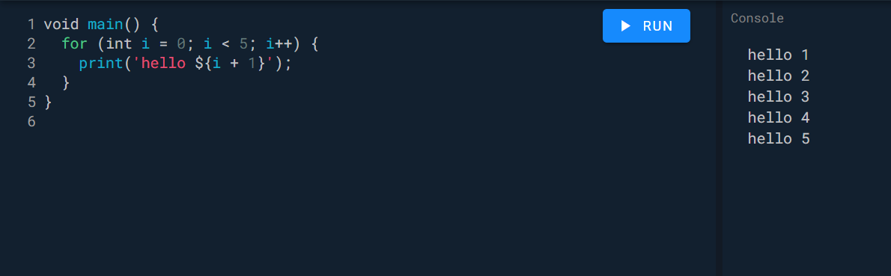
Dart is an object oriented language with C-style syntax
Dart is object-oriented programming language it supports interfaces, classes, collections, generics etc.

Slide 9
The Resurrection of Dart by Flutter
In late 2013, Google unveiled Dart (version 1.0) as a general-purpose programming language.
It was meant as a replacement for JavaScript in browsers.
It had its own virtual machine (VM) for running native applications in the Chrome browser.
However, developers still preferred to stick with JavaScript.
But that wasn’t the end of Dart…….....
Upon the emergence of Flutter, Google’s UI framework for building native interfaces in iOS and Android
Google announces Flutter code is going to be powered by the world-class Dart platform
Which enables compilation to native 32-bit and 64-bit ARM code for iOS and Android
Google is using Dart on Flutter to develop and run internal apps such as Google Ads for iOS and Android

Slide 10
The Power of Dart
Dart is a client-optimized language for fast applications on any platform
It has its own virtual machine (VM) for running native applications called Dart VM.
It also has its own package manager called Pub.

Slide 11
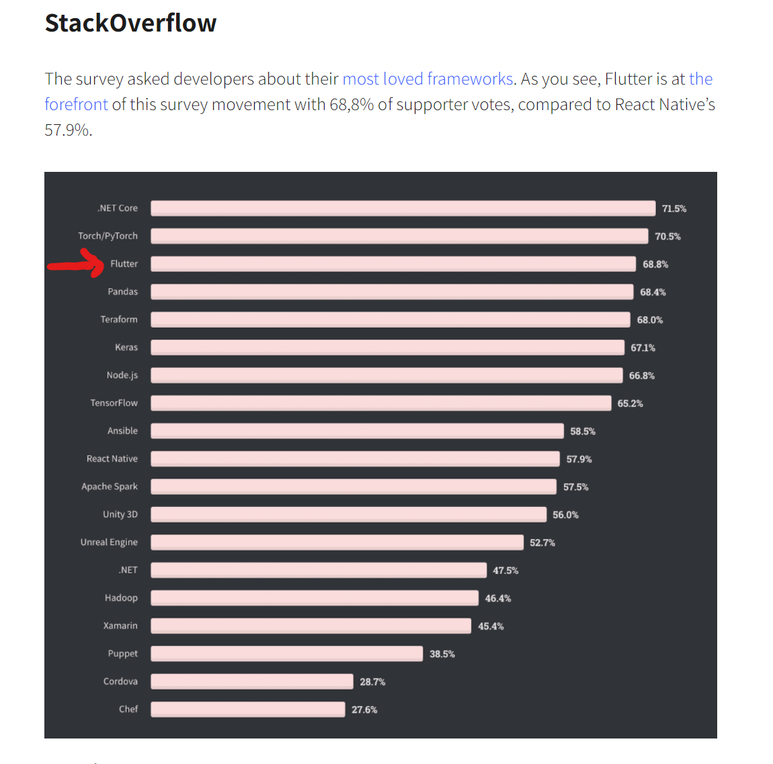

Slide 12
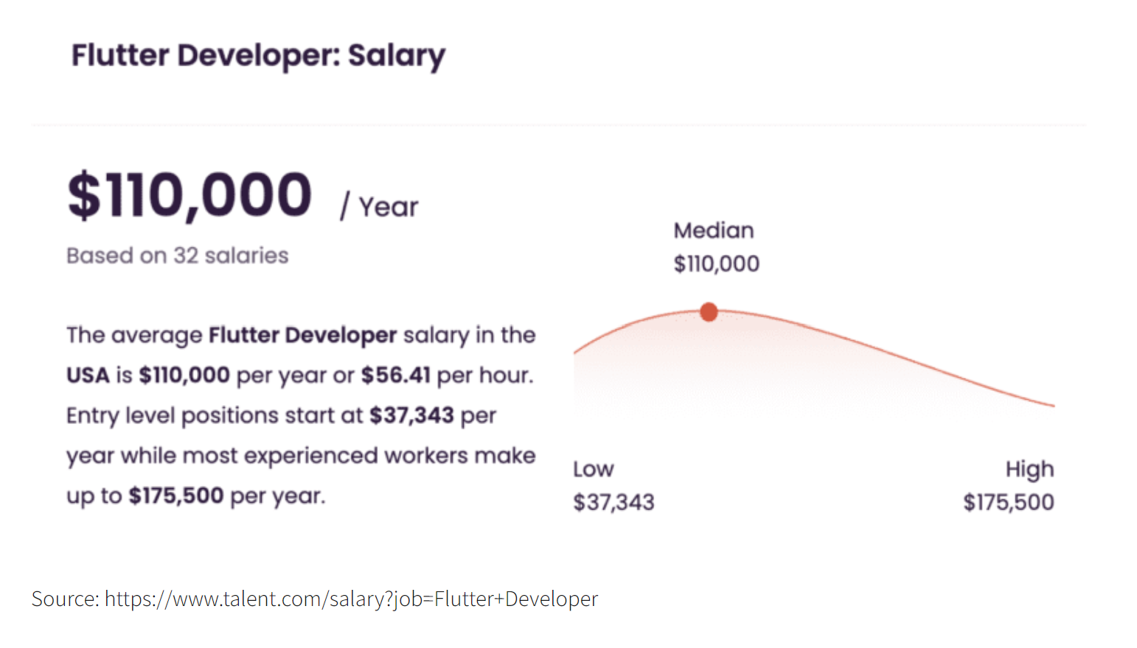

Slide 13
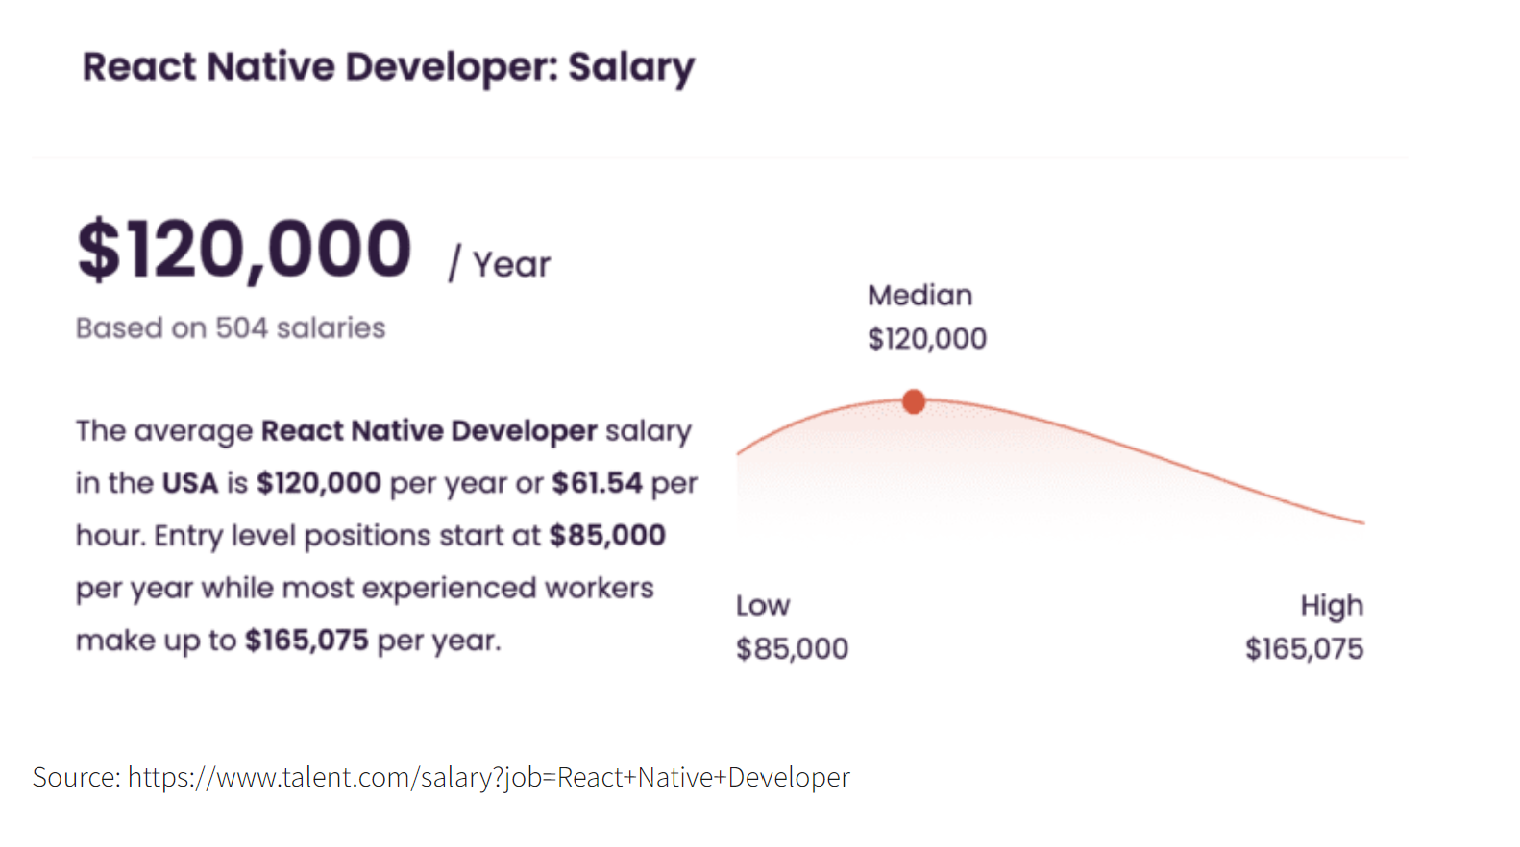

Slide 14
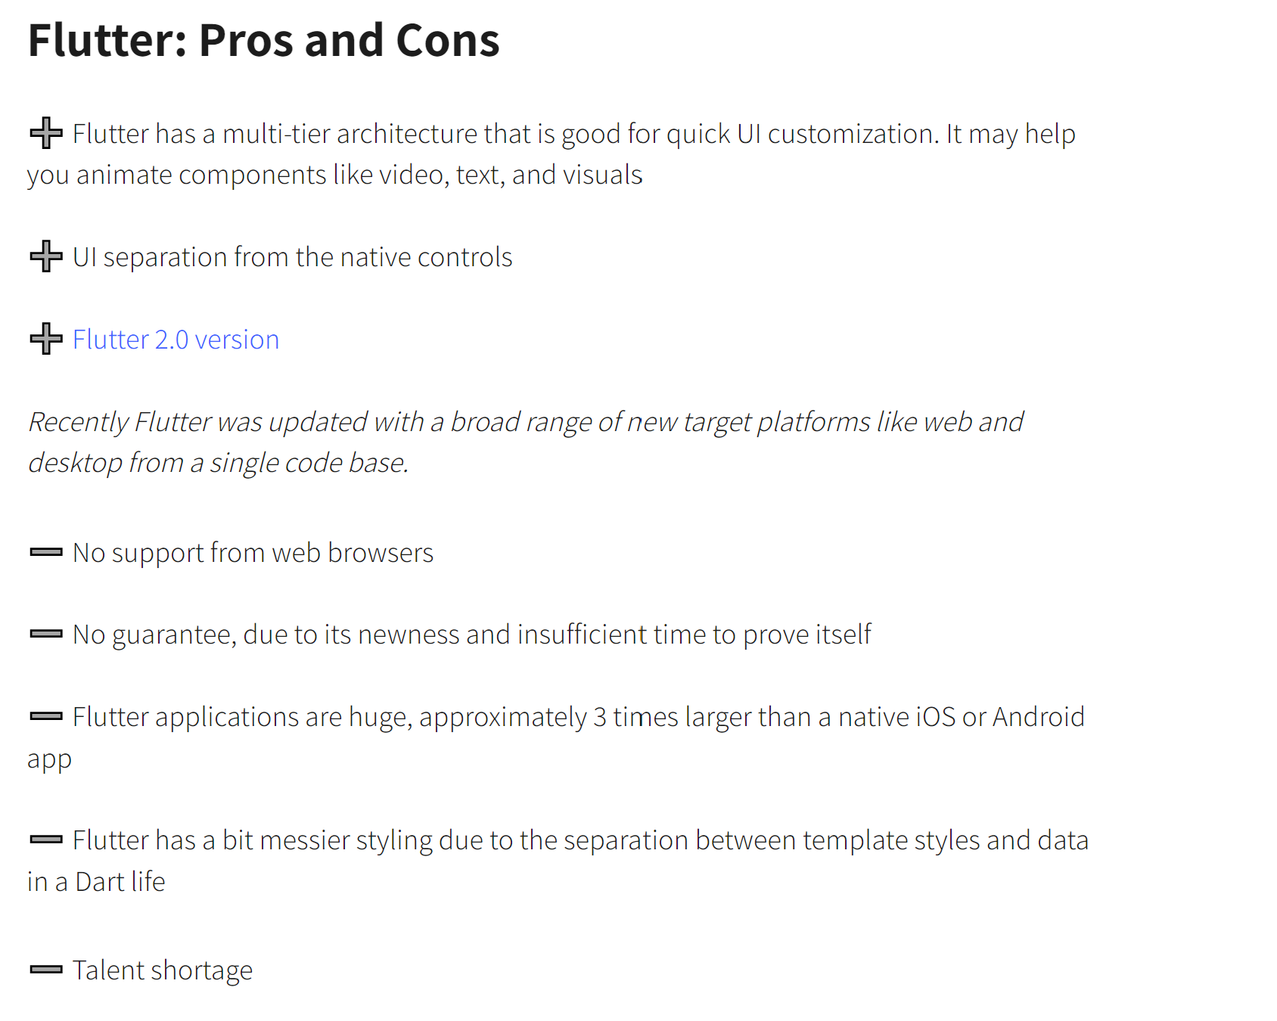

Slide 15
Use Case:
For real-quick startup apps with a limited budget
Dart is a go to for the projects where the functional side is more important:
healthy lifestyle apps
sleep
mood trackers

Slide 16
Objective:
Building shopping application that is native to iOS and Android
Testing the pros and cons of Dart in the development environment

